Slide 1
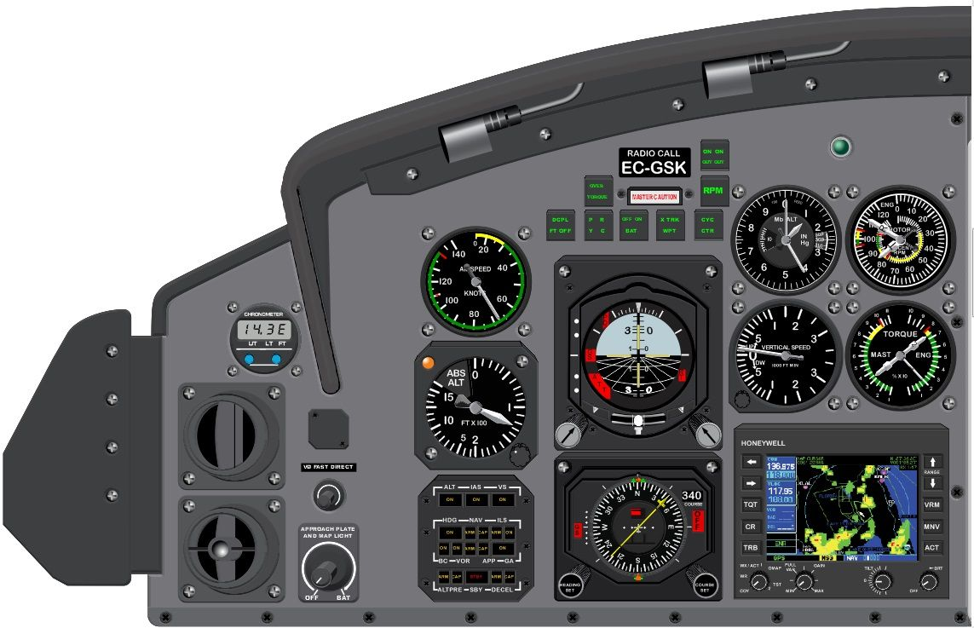
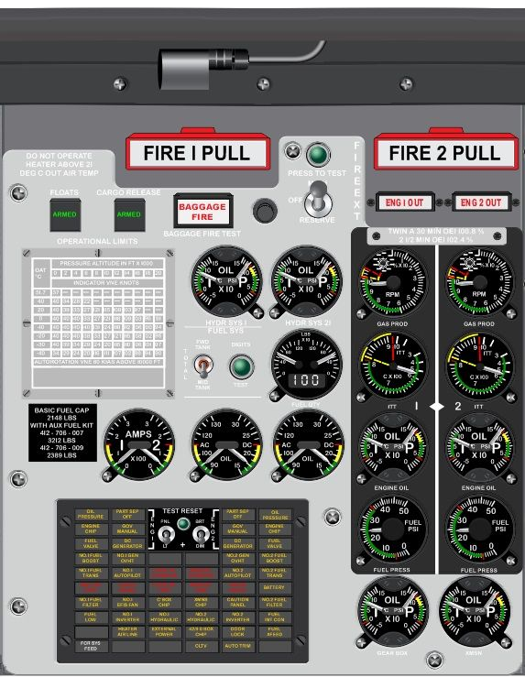
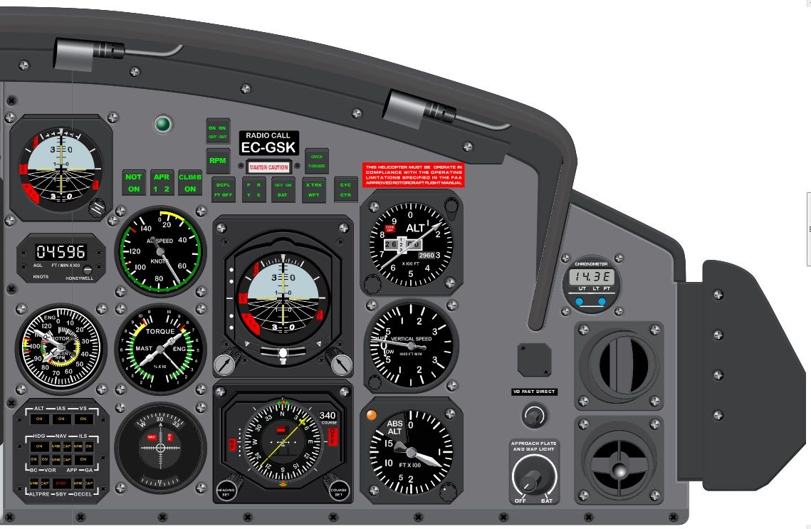

Slide 2
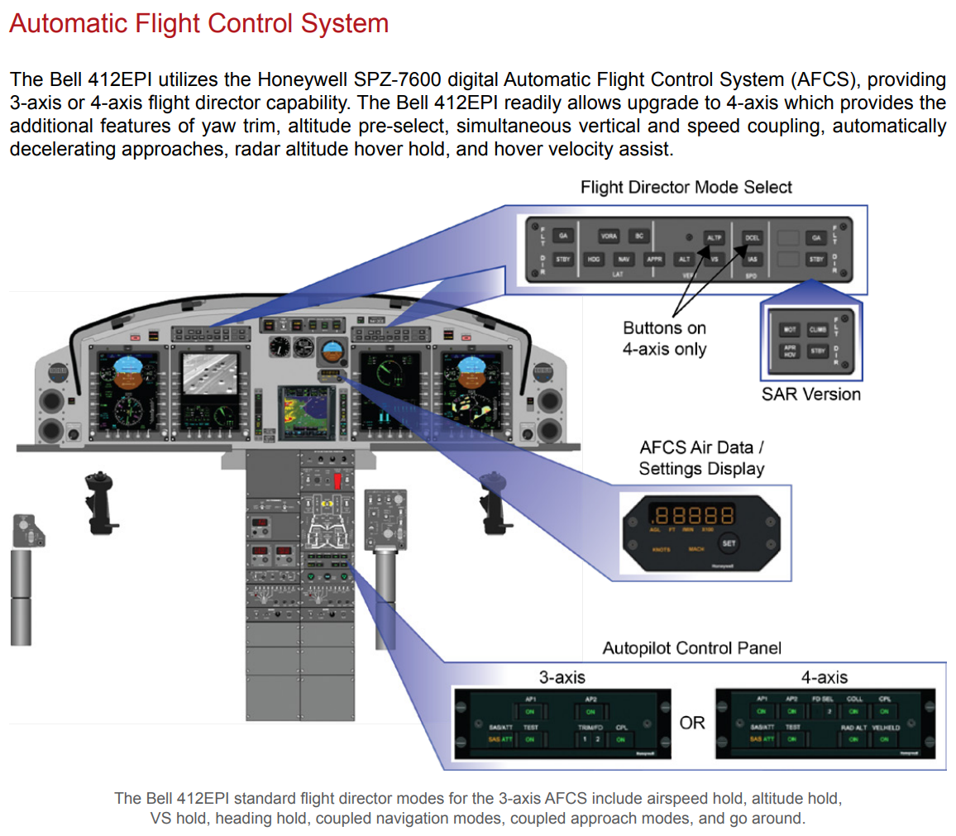
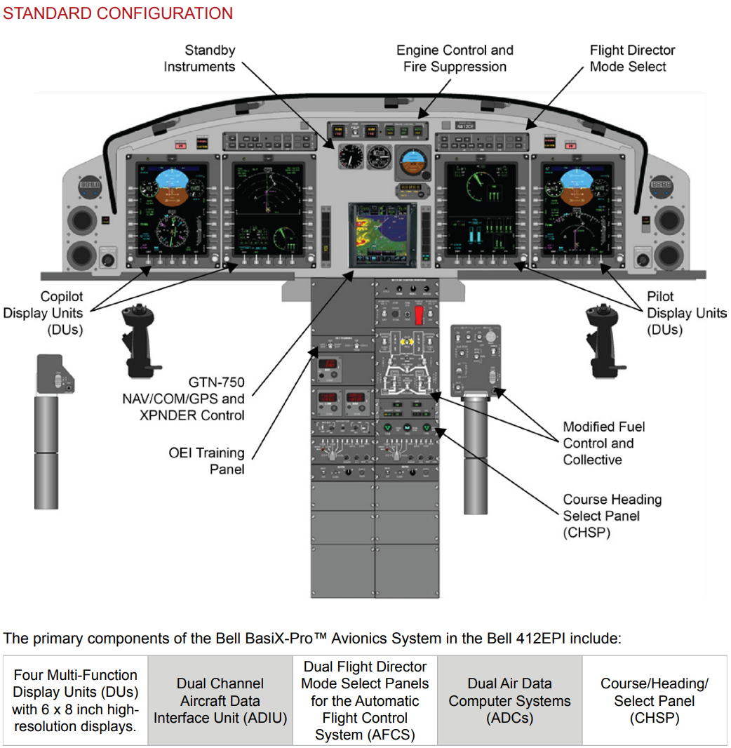
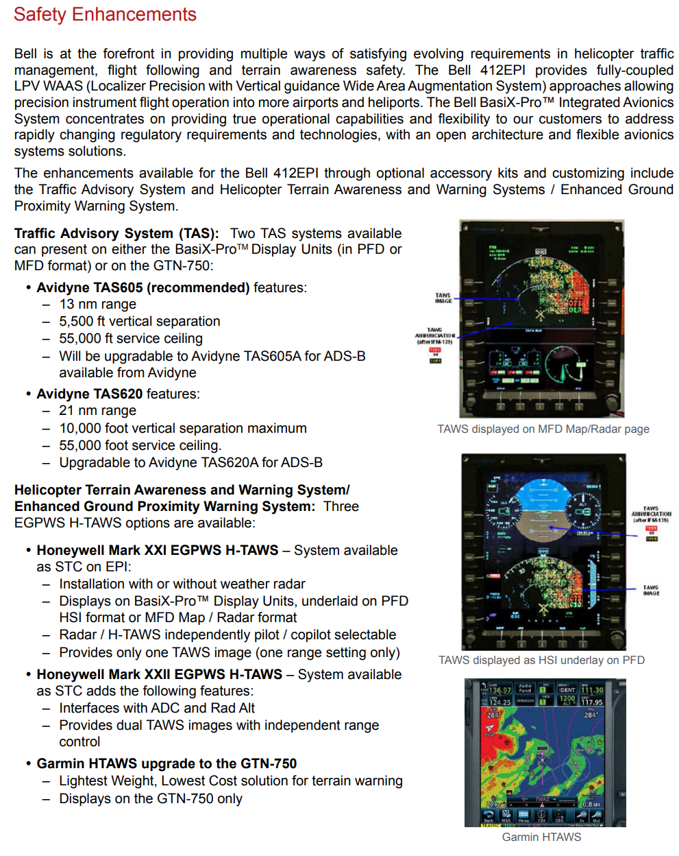
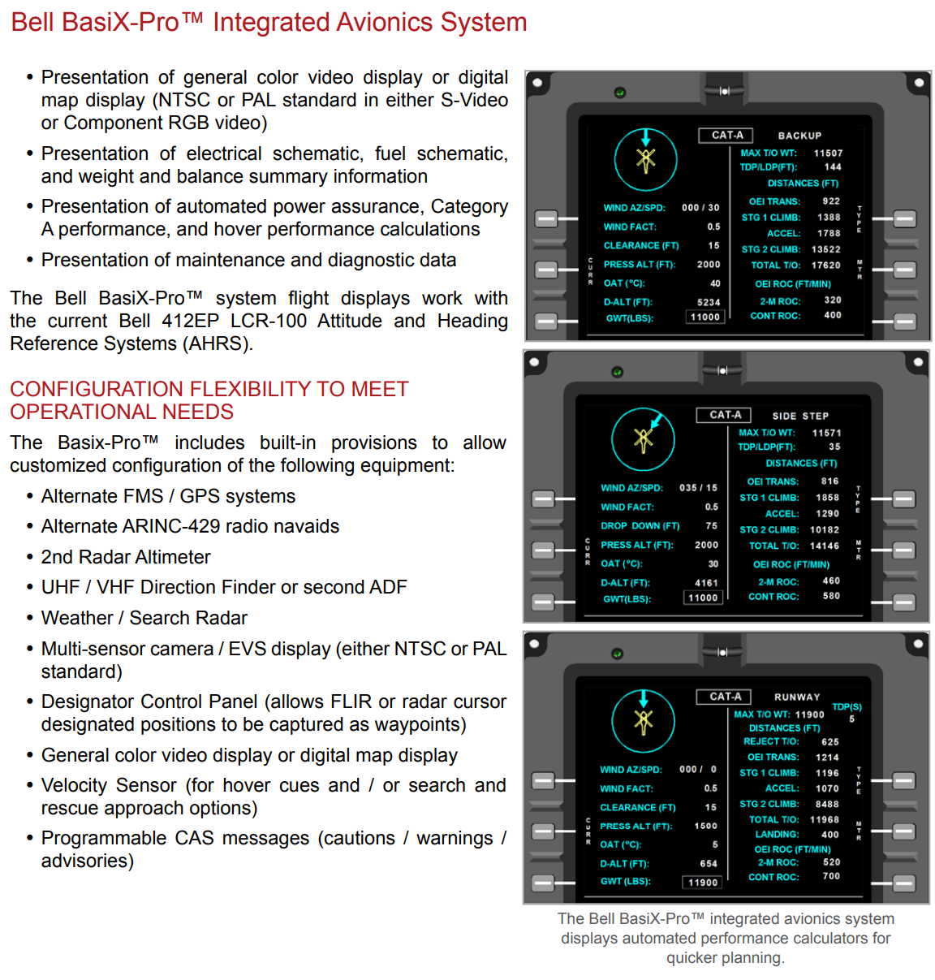
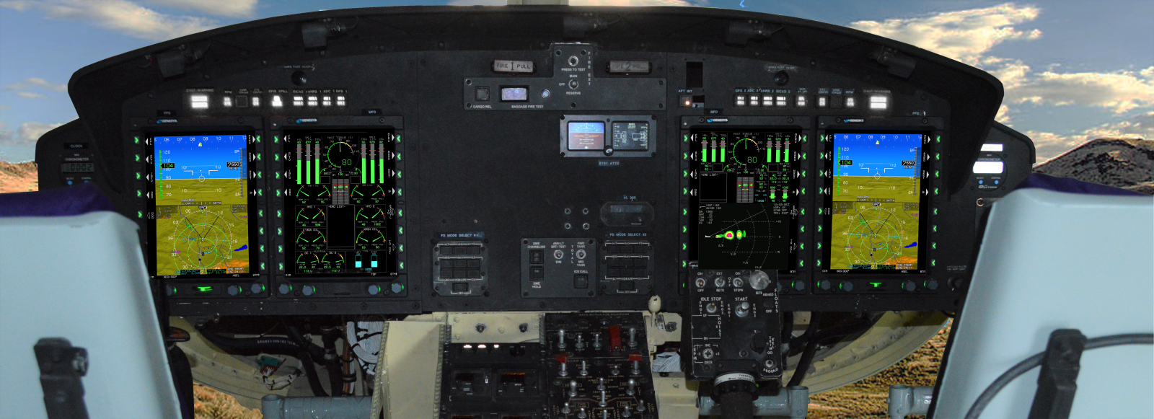
https://www.bellflight.com/-/media/site-specific/bell-flight/documents/products/412/bell-412epi-product-specifications.pdf

Slide 3
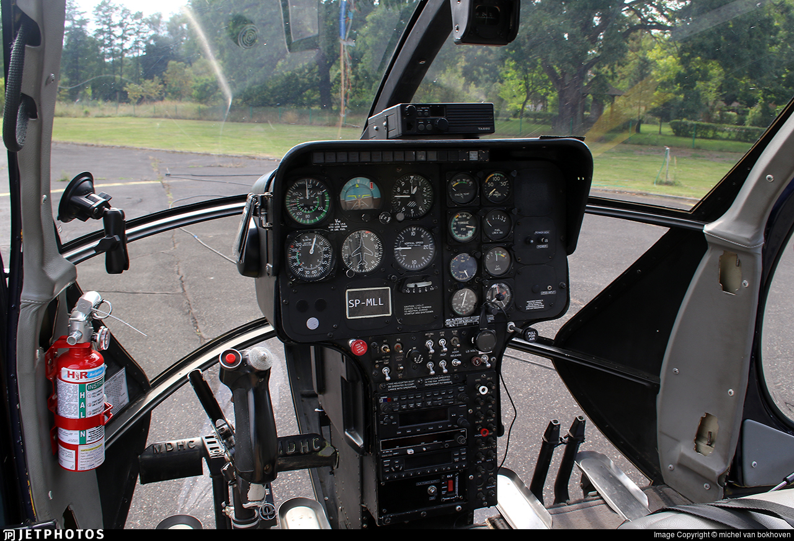
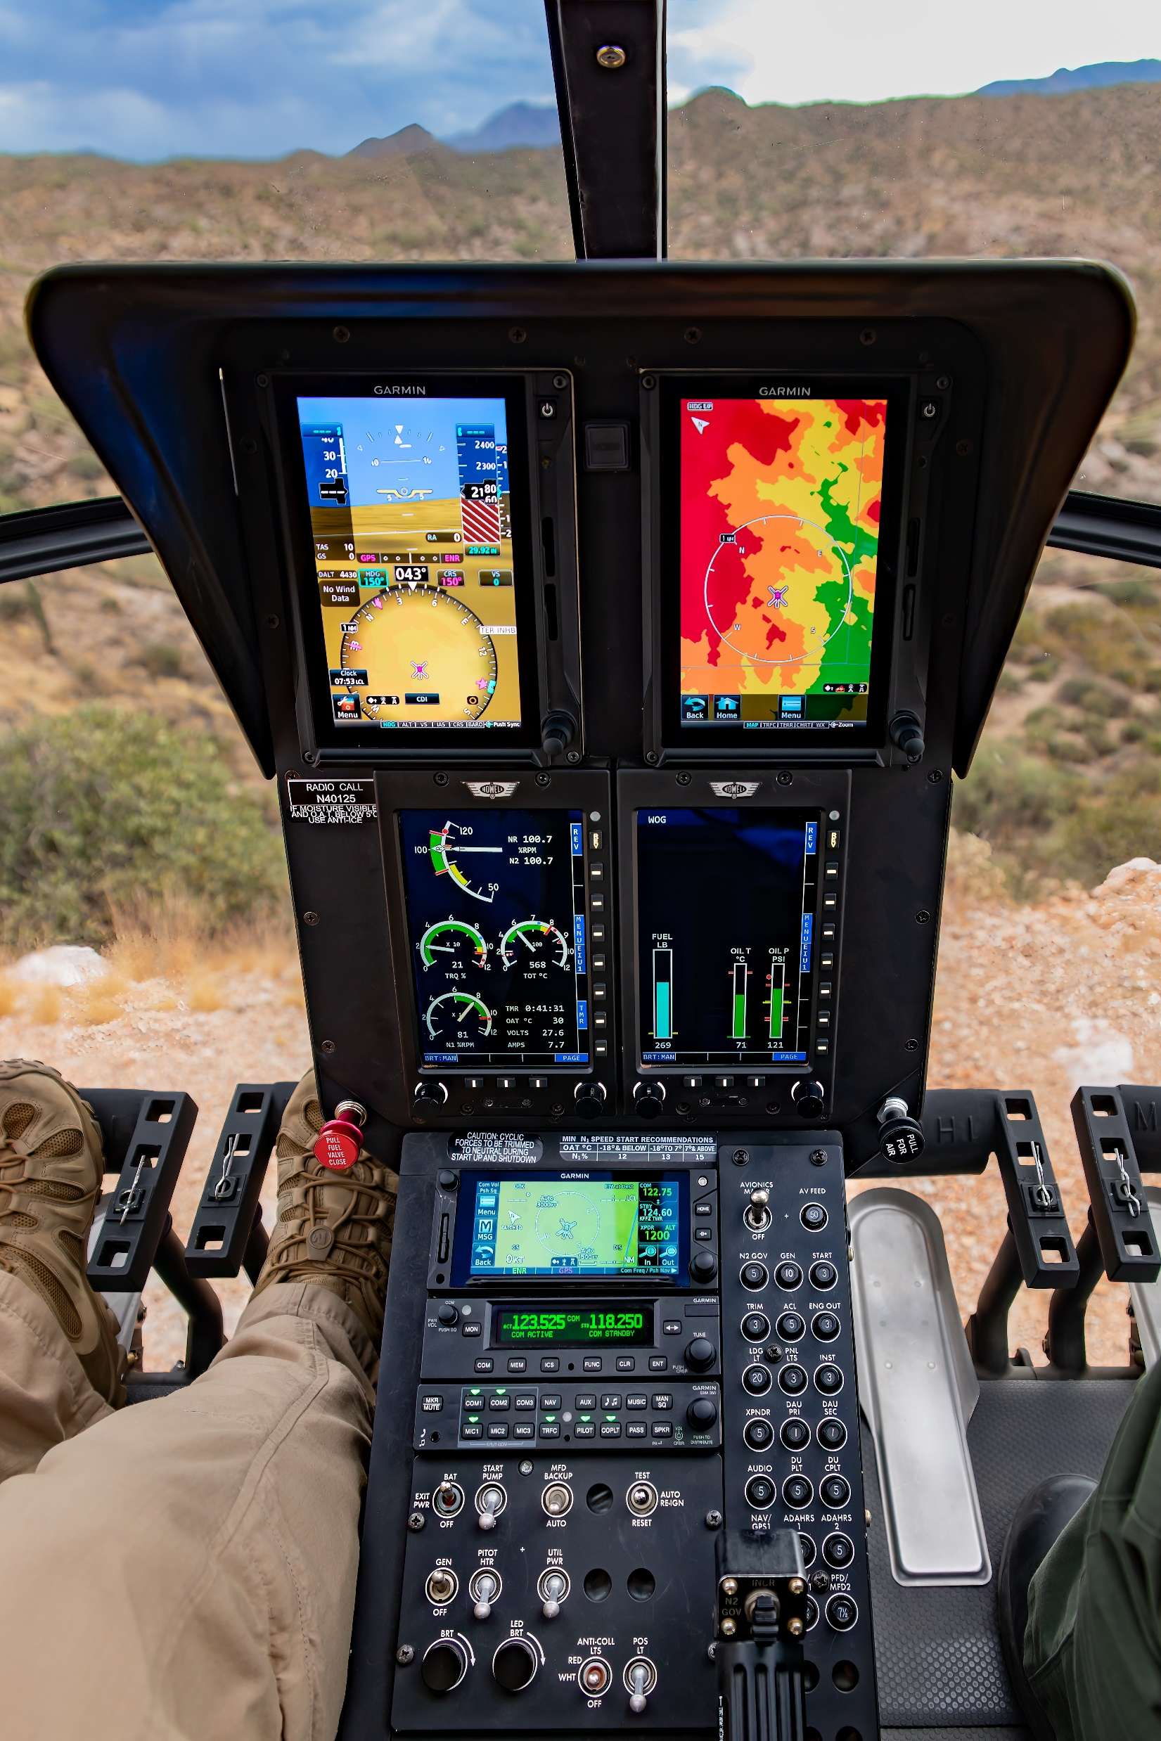
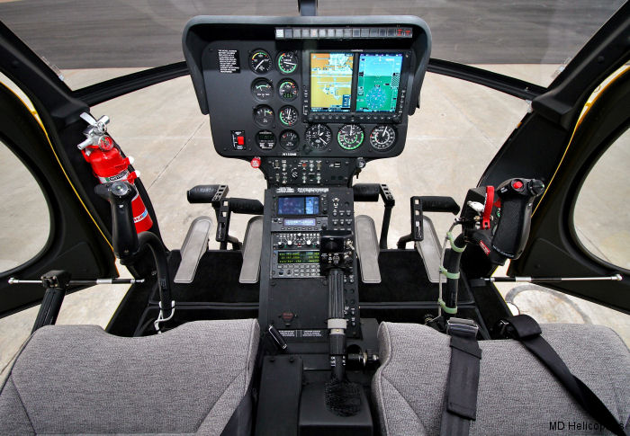

Slide 4
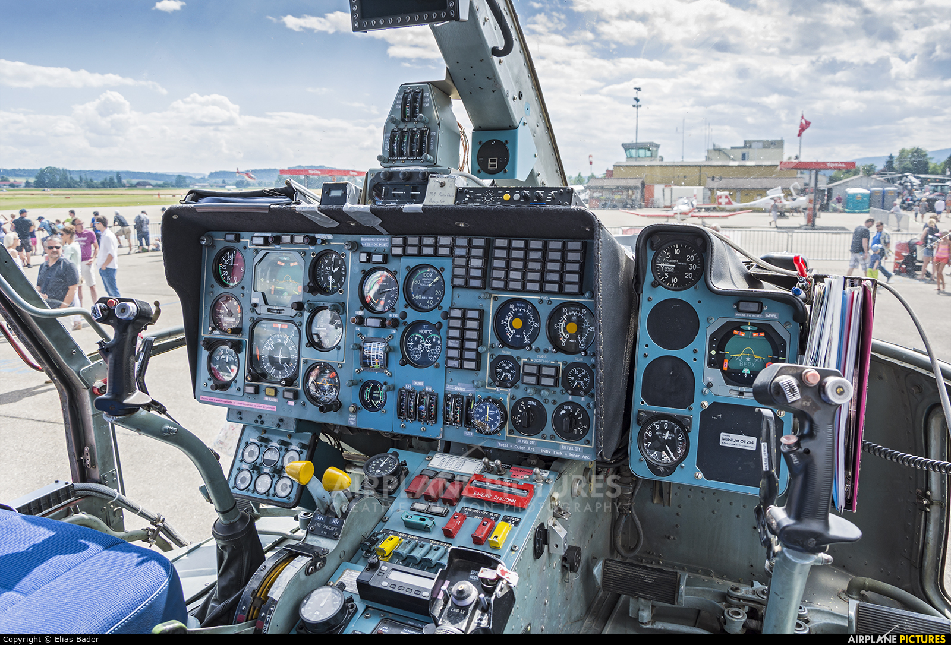
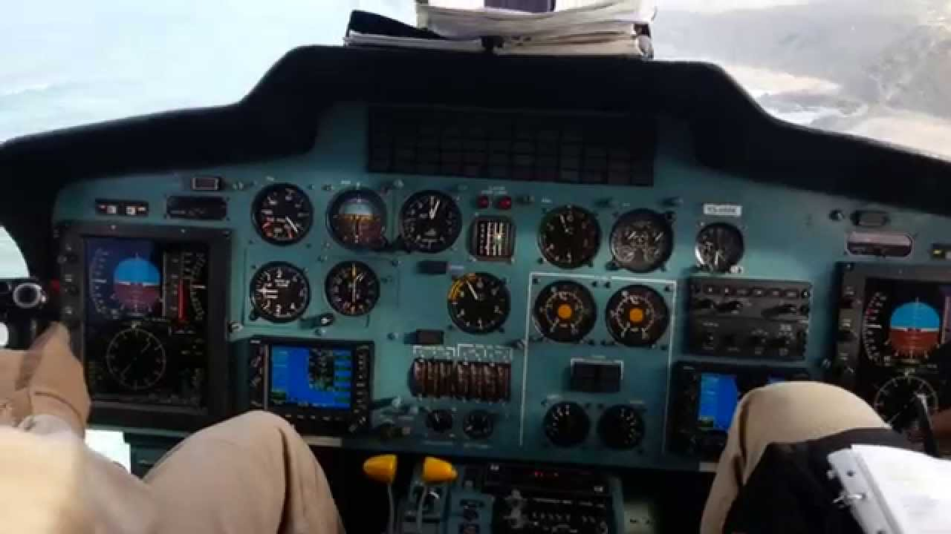

Slide 5
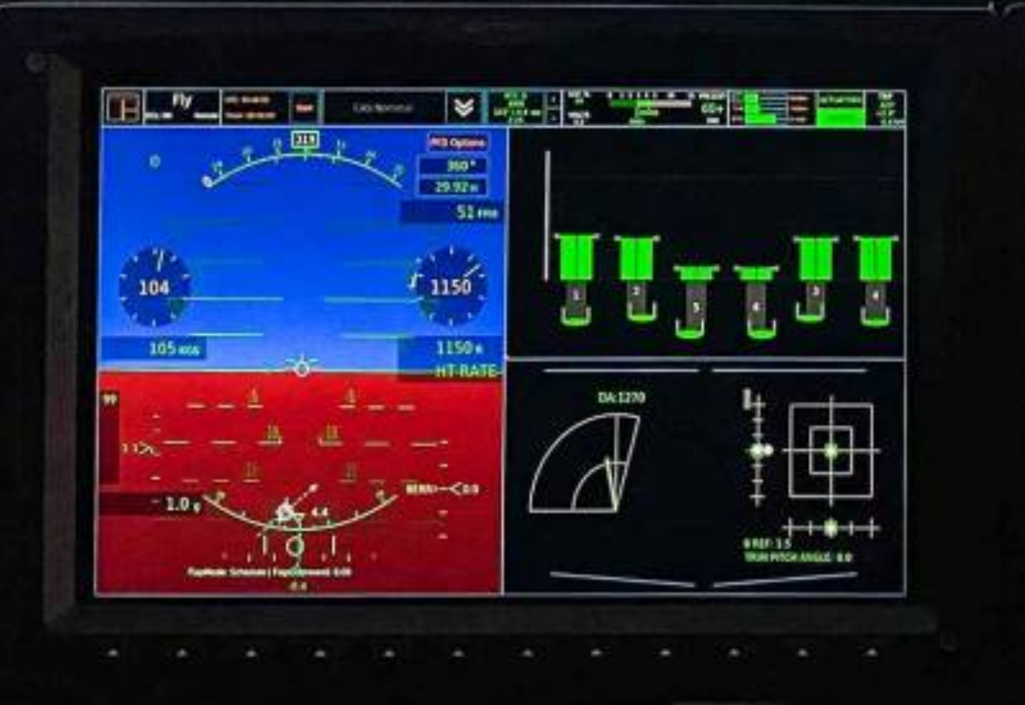

Slide 6
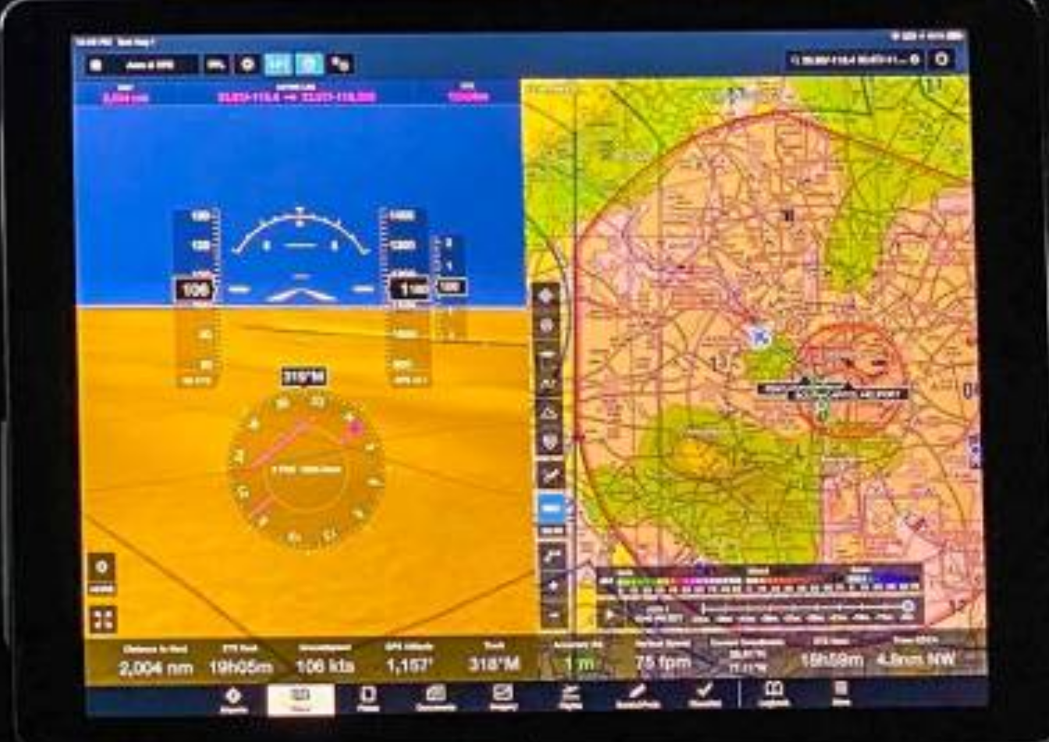

Slide 7
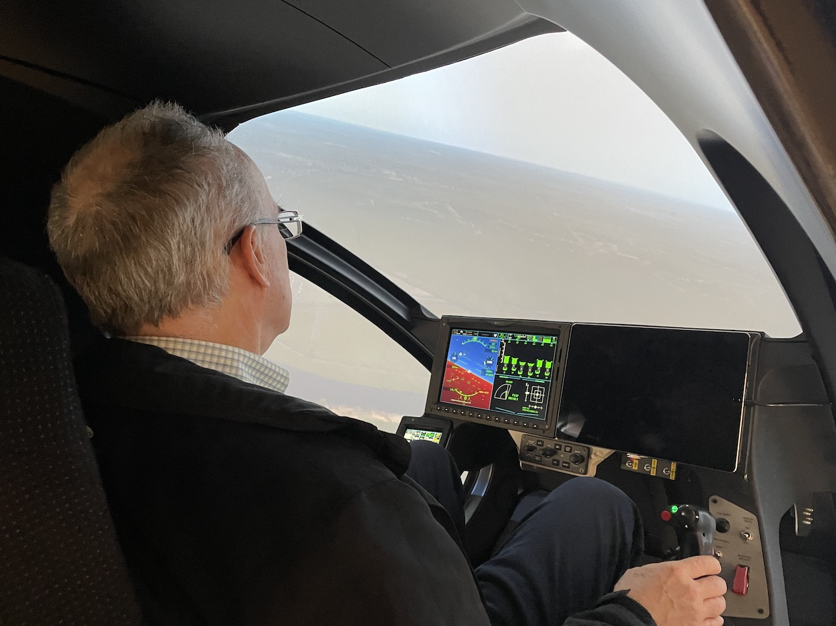

Slide 8
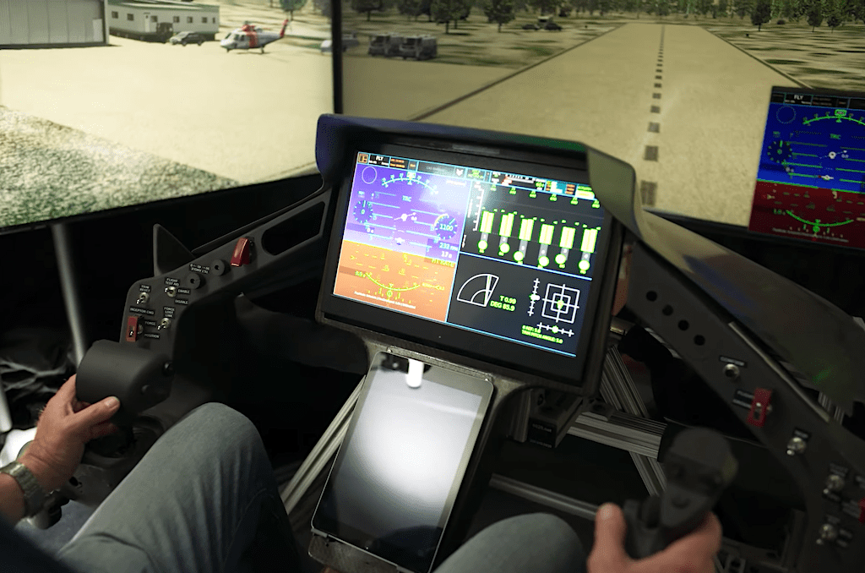

Slide 9
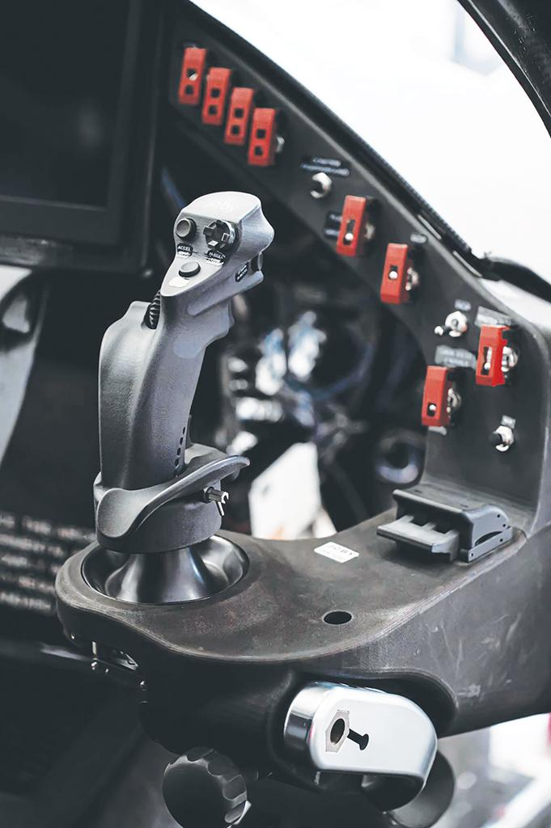

Slide 10
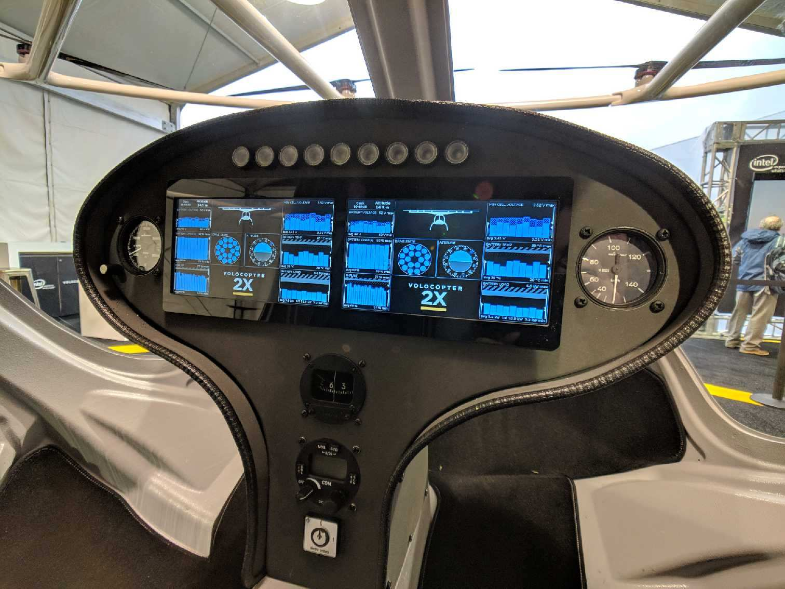

Slide 11
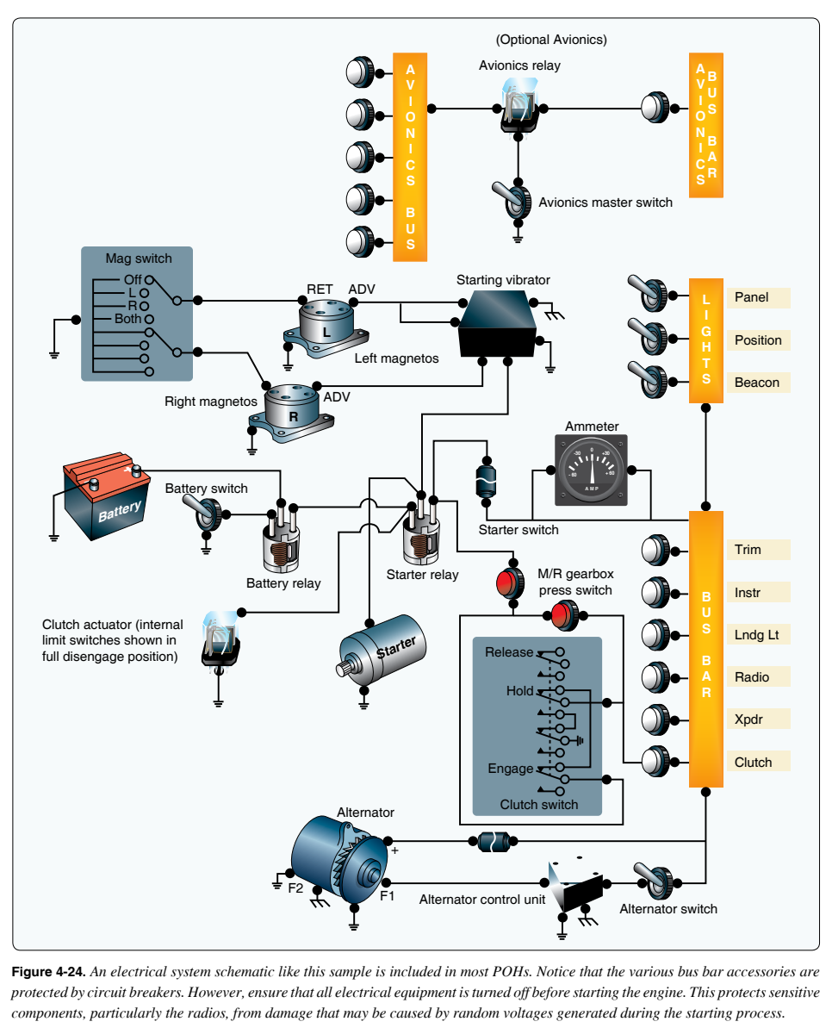

Slide 12
 | Bell412 | Bell 206 | AS350 | AS365 | H369 | KA-32 | R44 |  |  | UAM Aircraft
1 | Clock | Engine oil pressure/temperature indicator | Voltmeter | Airspeed indicator | Airspeed indicator | Airspeed indicator |  |  | Display 1a | Clock | Display
2 | Airspeed Indicator | Transmission oil pressure/temperature indicator | Fuel pressure indicator | Radal altimeter | Engine/Rotor tachometer | Radar altimeter |  |  |  | Attitude indicator
3 | Radar altimeter | Fuel quantity indicator | Oil pressure indicator | Clock | Couse select indicaotr | Hover airspeed |  |  |  | Vertical speed indicator
4 | Attitude indicator (Artificial horizon) | Fuel pressure indicator | Oil temperature indicator | Attitude director indicator | Attitude director indicator | Attitude indicator (Artificial horizon) |  |  |  | Horizon situation indicator
5 | Horizontal situation indicator | Torquemeter | Ammeter | Horizontal situation indicator | Heading indicator | Horizontal situation indicator |  |  |  | Airspeed indicator | on the left of horizon indicator
6 | Barometric altimeter | Turbine outlet temperature | Course select indicator | Barometric altimeter | ADF indicator | Vertical speed indicator |  |  |  | Radar altimeter | on the right of horizon indicator
7 | Vertical speed indicator | Gas producer tachometer | Clock | Vertical speed indicator | Barometric altimeter | Standby attitude indicator |  |  |  | Heading indicator
8 | Triple tachometer | Clock | Tachometer | Rotor tachometer | Vertical speed indicator | Barometric altimeter
9 | Triple torquemeter | Airspeed indicator | Rotor Tachometer | Interturbine tachometer | Chronometer | Clock |  |  | Display 1b | Motor/Rotor RPM (Tachometer) x 4/9/8 | inner circle with number
10 | Caution light panel | Rotor/turbine tachometer | ADF indicator | Interturbine tachometer | Engine oil temperature indicator | Interturbine tmperature indicator |  |  |  | Torquemeter x 4/9/8 | outer circle
11 | Hydraulic pressure/temperature indicator | ADF indicator | Barometric altimeter | Engine oil pressure/temperature indicator | Torquemeter | Hydraulic pressure/temperature indicator |  |  |  | Battery capacity indicator x 4 | default, bar graph, Low battery level warning light: green --> red
12 | Hydraulic pressure/temperature indicator | Attitude indicator (Artificial horizon) | Vertical speed indicator | Engine oil pressure/temperature indicator | Turbine out temperature | Hydraulic pressure/temperature indicator |  |  |  | Battery max cell voltgage indicator x 4
13 | Fuel quantity indicator | Horizontal situation indicator | Torquemeter | Fuel pressure indicator | Gas producer tachometer | Doppler |  |  |  | Battery voltage indicator x 4 | optionally display by selection
14 | Dual voltmeter | Course select indicator | Attitude indicator (Aritifical horizon) | Fuel pressure indicator | Engine oil pressure indicator | Horizontal situation indicator |  |  |  | Battery temperature indicator x 4 | optionally display by selection
15 | Dual voltmeter | Barometric altimeter | Horizontal situation indicator | Hydraulic pressure/temperature indicator | Fuel quantity indicator | Airspeed indicator |  |  |  | Ammeter x 4 | optionally display by selection
16 | Duacl DC ammeter | Vertical speed indicator | Clock | Hydraulic pressure/temperature indicator | Ammeter | Radar altimeter |  |  |  | Battery fire | Caution light
17 | Gas producer tachometer | Inclinometer | Airspeed indicator | Main gearbox oil pressure/temperature indicator | Clock | Attitude indicator (Artificial horizon)
18 | Gas producter tachometer |  | Heading indicator | Voltmeter |  | Vertical speed indicator |  |  | Display 2a | Attitude indicator (Aritificial horizon) | Synthetic vision 3 in 1
19 | Interturbine temperature indicator |  |  | Ammeter |  | Standby attitude indicator |  |  |  | Airspeed indicator (TAS, Air speed, GS)
20 | Interturbine temperature indicator |  |  | Gas producer tachometer |  | Barometric altimeter |  |  |  | Radar altitude indicator
21 | Engine oil pressure/temperature indicator |  |  | Gas producer tachometer |  |  |  |  |  | Vertical climb rate
22 | Engine oil pressure/temperature indicator |  |  | Fuel quantity indicator |  |  |  |  |  | Horizontal situation indicator
23 | Fuel pressure indicator |  |  | Torquemeter |  |  |  |  |  | Active flight plan
24 | Fuel pressure indicator |  |  | Standby attitude indicator |  |  |  |  |  | Time | at the bottom
25 | Gearbox oil pressure/temperature indicator |  |  | Tachometer
26 | Transmission oil pressure/temperatuer indicator |  |  | Airspeed indicator |  |  |  |  | Display 2c | Electric system architecture
27 | Standby attitude indicator |  |  | Course slect indicator |  |  |  |  |  | Navigation map
28 | Clock |  |  | Clock |  |  |  |  |  | Radio
29 | Airspeed Indicator |  |  | Attitude indicator (Aritificial horizon) |  |  |  |  |  | Runway (Vertiport)
30 | Radar altimeter |  |  | Horizontal situation indicator |  |  |  |  |  | Weather
31 | Attitude director indicator |  |  | Barometric altimeter |  |  |  |  |  | NOTAM
32 | Horizontal situation indicator |  |  | Vertical speed indicator |  |  |  |  |  | AOPA | Vertiport information
33 | Barometric altimeter |  |  | Radal altimeter
34 | Vertical speed indicator |  |  |  |  |  |  |  | Right front panel | Panel light switch | Switch
35 | Triple tachometer |  |  |  |  |  |  |  |  | Position light switch | Switch
36 | Triple torquemeter |  |  |  |  |  |  |  |  | Beacon light switch | Switch
37 | DME (Distance Measurement Equipment) indicator |  |  |  |  |  |  |  |  | Landing light switch | Switch
 |  |  |  |  |  |  |  |  |  | Battery switch x 4/5/4 | Switch
 |  |  |  |  |  |  |  |  |  | Avionics master switch | Switch
 |  |  |  |  |  |  |  |  |  | Trim | Button
 |  |  |  |  |  |  |  |  |  | Instrument
 |  |  |  |  |  |  |  |  |  | Radio (COM1/COM2)
 |  |  |  |  |  |  |  |  |  | NAV
 |  |  |  |  |  |  |  |  |  | XPDR

